Slide 1

Algebra 1
Unit 4, Lesson 2 Identifying Key Features of Lines From Graphs Volume 1, pg. 169

Slide 2


Benchmark
MA.912.AR.2.4
Given a table, equation, or written description of a linear function, graph that function, and determine and interpret its key features.
volume 1, pg. 169

Slide 3
Integrated Mathematical Thinking and Reasoning Standards
MA.K12.MTR.1.1 Actively participate in effortful learning both individually and collectively.
MA.K12.MTR.2.1 Demonstrate understanding by representing problems in multiple ways.
MA.K12.MTR.4.1 Engage in discussions that reflect on the mathematical thinking of self and others.
MA.K12.MTR.5.1 Use patterns and structure to help understand and connect mathematical concepts.
volume 1, pg. 169

Slide 4

Learning Target
I can identify key features of a linear function from a graph.
volume 1, pg. 169

Slide 5

Warm-Up
volume 1, pg. 169

Slide 6
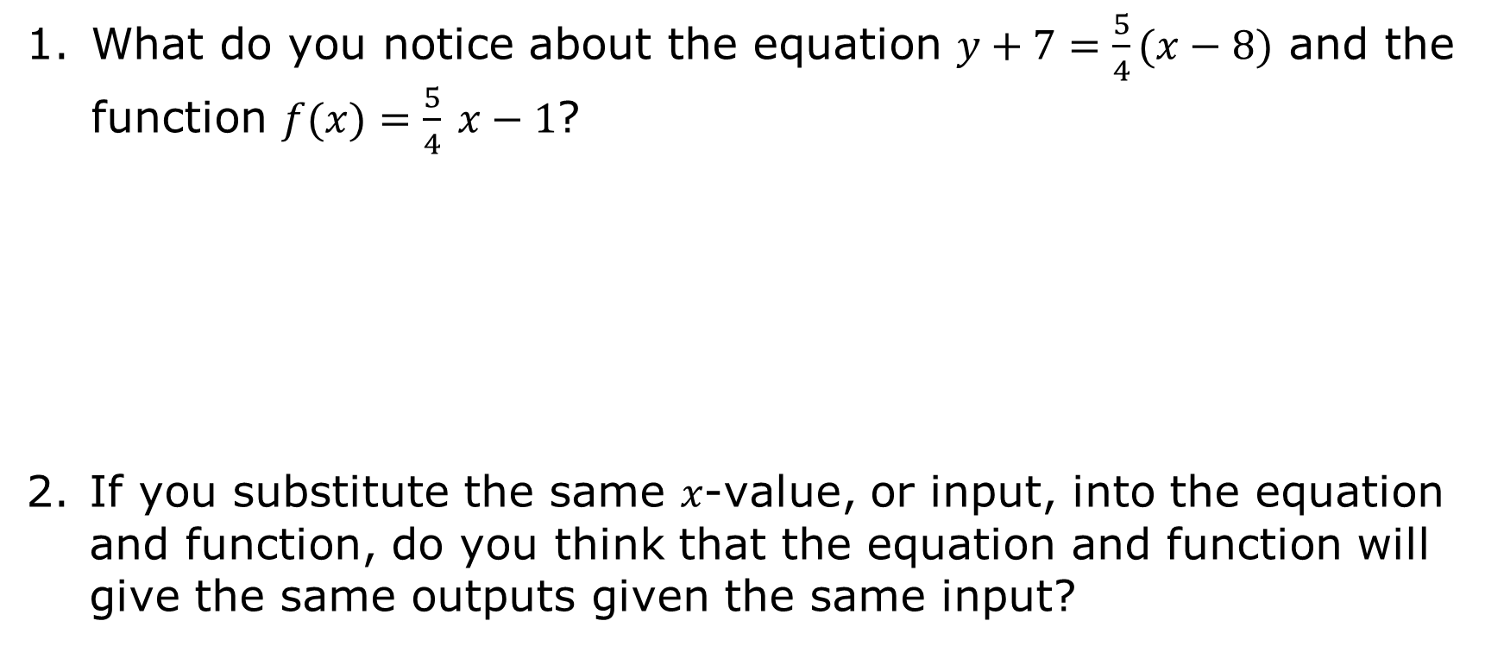
4.2.1 Warm-Up: What Do You Notice?
What do you notice about the equation $y+7=\frac{5}{4}(x−8)$ and the function $f(x)=\frac{5}{4} x−1$?
If you substitute the same 𝑥-value, or input, into the equation and function, do you think that the equation and function will give the same outputs given the same input?
volume 1, pg. 169
Notes:
Video Link: https://algebranation.wistia.com/medias/fi4fidi5y8

Slide 7
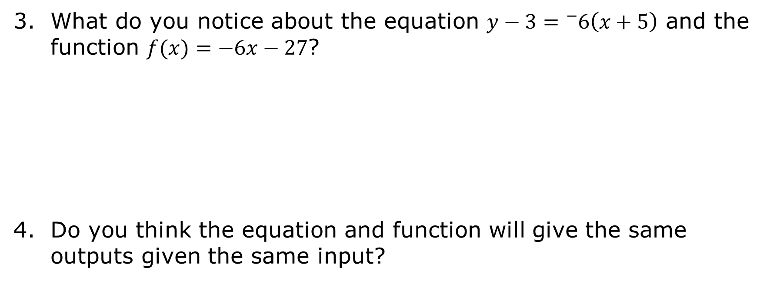
What do you notice about the equation $y−3={}_{}^{−}6\left(x+5\right)$ and the function $f(x)=−6x−27$?
Do you think the equation and function will give the same outputs given the same input?
volume 1, pg. 169

Slide 8
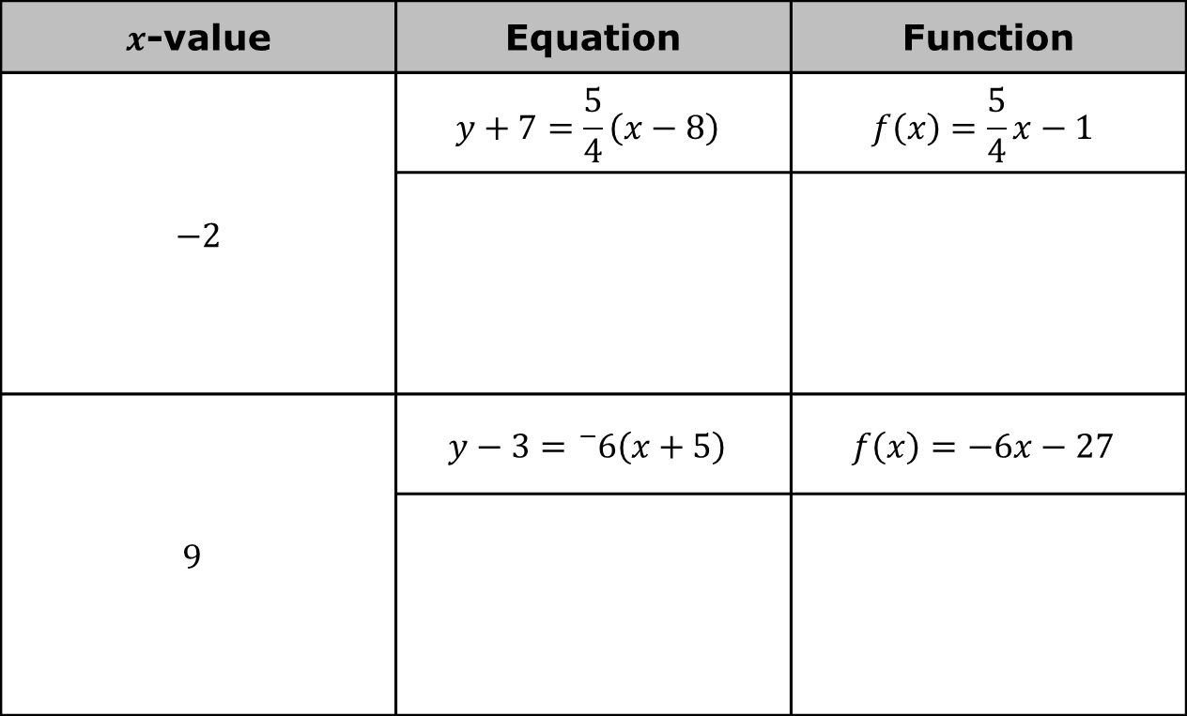
Substitute the 𝑥-value in the equation and the function to determine if the output is the same.
$x$-value | Equation | Function
$−2$ | $$y+7=\frac{5}{4}\left(x−8\right)$$ | $$f\left(x\right)=\frac{5}{4}x−1$$
$$9$$ | $$y−3={}_{}^{−}6\left(x+5\right)$$ | $$f\left(x\right)=−6x−27$$
volume 1, pg. 170

Slide 9
What is one observation you have about the equation and function that do not have the same output?
What is one observation you have about the equation and function that do have the same output?
volume 1, pg. 170

Slide 10

Exploration
volume 1, pg. 170

Slide 11

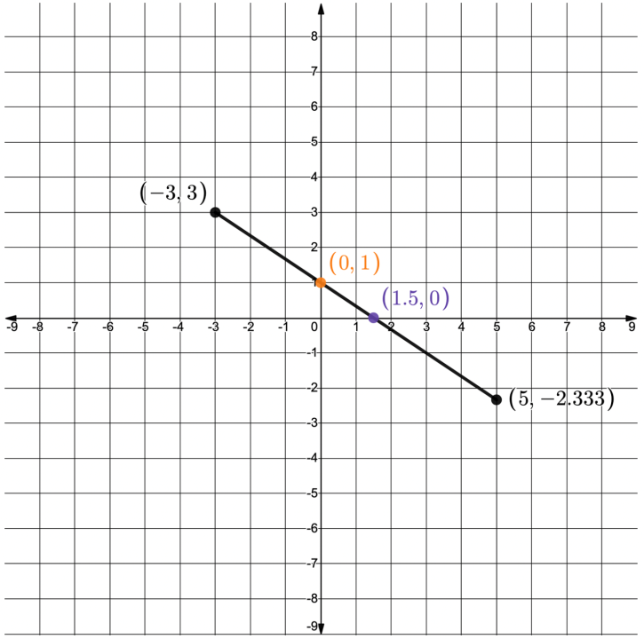
4.2.2 Exploration: Key Features From a Graph
A line segment is shown on the coordinate plane. The line segment represents a function.
volume 1, pg. 170

Slide 12
Draw a vertical line from the left endpoint of the line segment to the 𝑥-axis. What is the 𝑥-value?
Draw a vertical line from the right endpoint of the line segment to the 𝑥-axis. What is the 𝑥-value?
volume 1, pg. 170

Slide 13
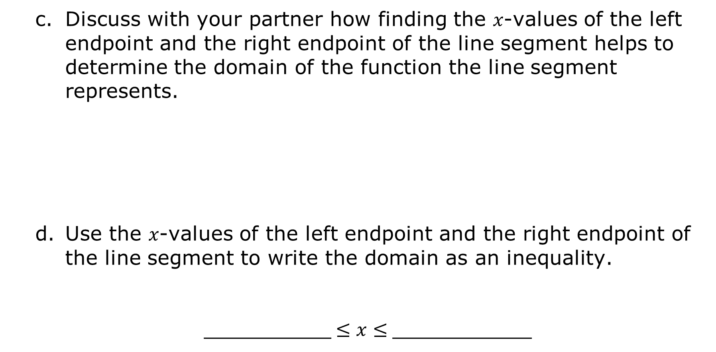
Discuss with your partner how finding the 𝑥-values of the left endpoint and the right endpoint of the line segment helps to determine the domain of the function the line segment represents.
Use the 𝑥-values of the left endpoint and the right endpoint of the line segment to write the domain as an inequality.
__________$≤x≤$___________
volume 1, pg. 171

Slide 14
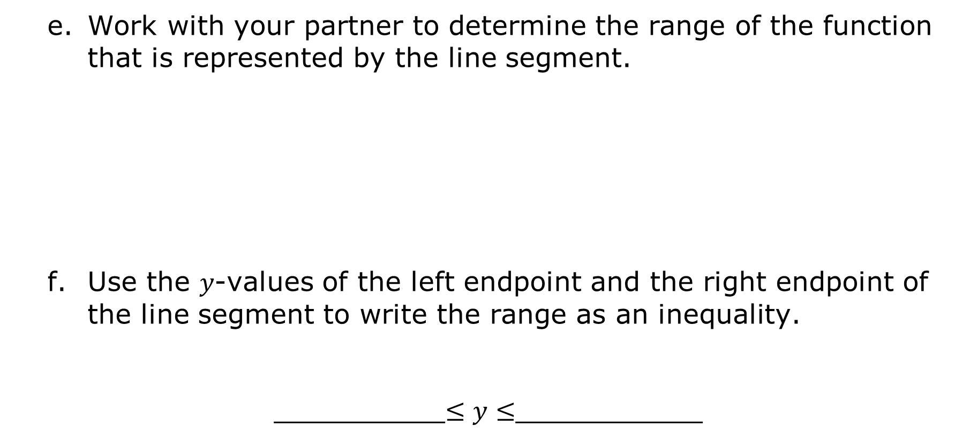
Work with your partner to determine the range of the function that is represented by the line segment.
Use the 𝑦-values of the left endpoint and the right endpoint of the line segment to write the range as an inequality.
__________$≤y≤$___________
volume 1, pg. 171

Slide 15

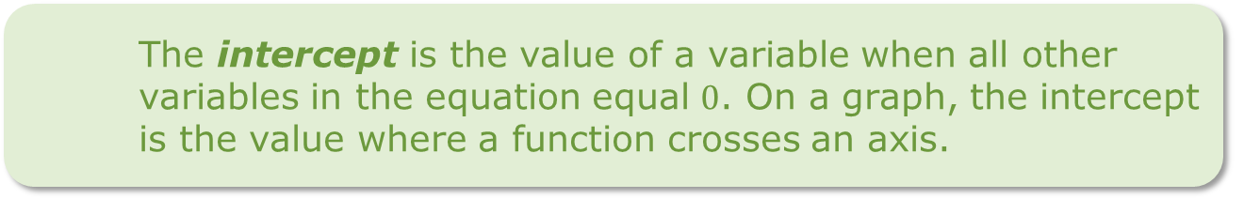
Work with your partner to find the other key features of the line segment.
The slope of the line segment is __________.
As the 𝑥-values are increasing, the 𝑦-values are _________________.
The coordinates of the point where the line crosses the 𝑦-axis are _________. The 𝑦-value of the point is ________.
The coordinates of the point where the line crosses the 𝑥-axis are _________. The 𝑥-value of the point is ________.
The intercept is the value of a variable when all other variables in the equation equal $0$. On a graph, the intercept is the value where a function crosses an axis.
volume 1, pg. 171

Slide 16
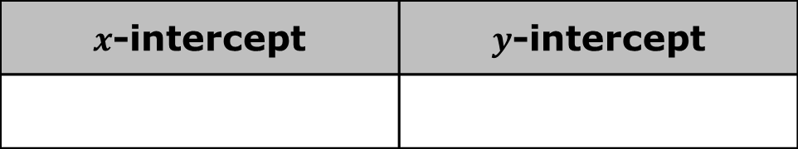
Work with your partner to use the definition of intercept to determine the intercepts.
$x$-intercept | $y$-intercept
volume 1, pg. 171

Slide 17
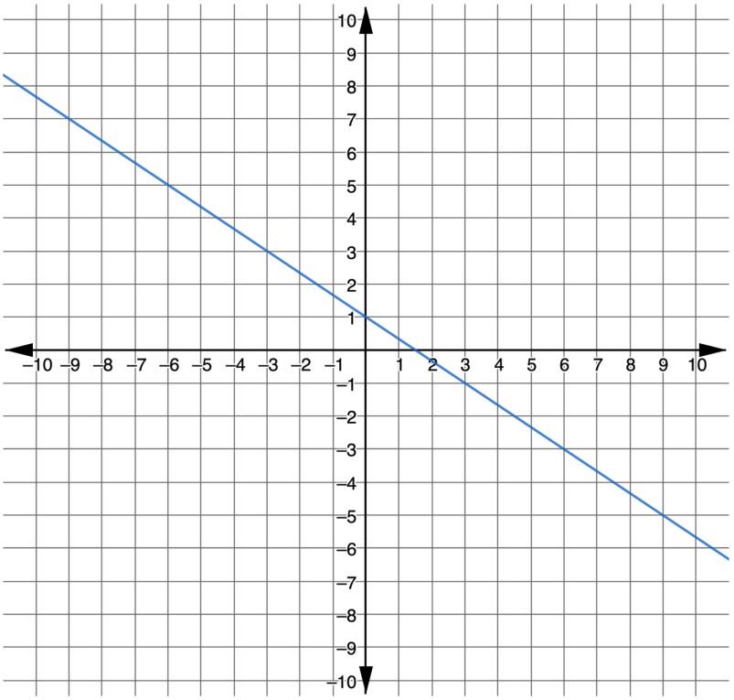
A line that represents a function is shown on the coordinate plane. The line is similar to the line segment represented in the previous problem except it does not have endpoints.
volume 1, pg. 172

Slide 18
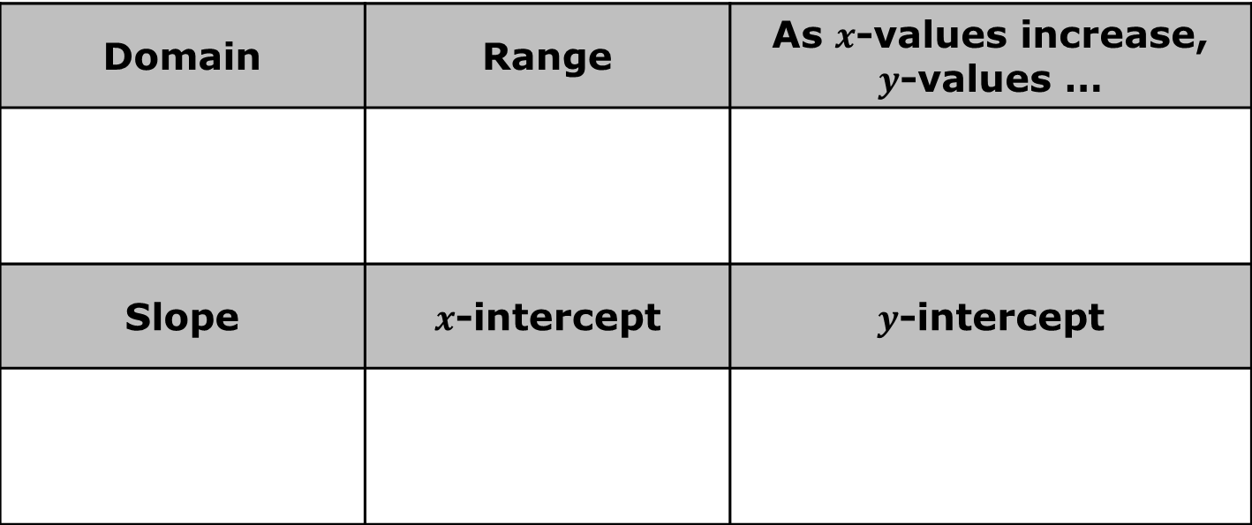
Work with your partner to find the key features of the line.
Domain | Range | As $x$-values increase, $y$-values …
Slope | $x$-intercept | $y$-intercept
Which key features were different for the line and line segment?
volume 1, pg. 172

Slide 19
Exploration
volume 1, pg. 173

Slide 20
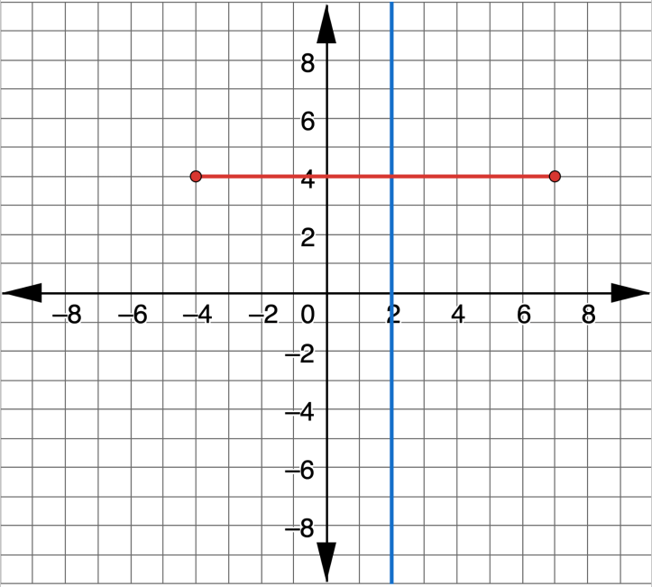
4.2.3 Exploration: Horizontal and Vertical Lines
The graph shows a vertical line in blue and a horizontal line segment in red.
volume 1, pg. 173

Slide 21
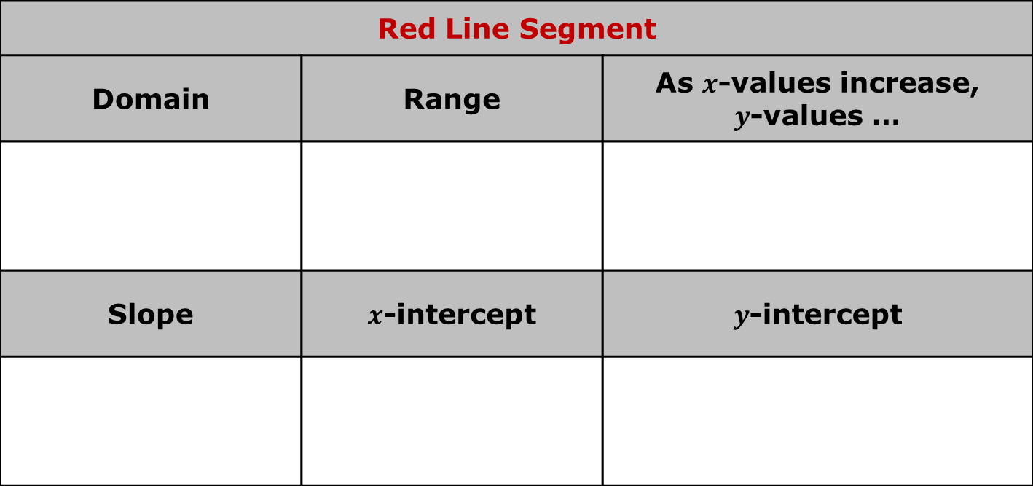
Work with your partner to find the key features for each.
Red Line Segment
Domain | Range | As $x$-values increase, $y$-values …
Slope | $x$-intercept | $y$-intercept
volume 1, pg. 173

Slide 22
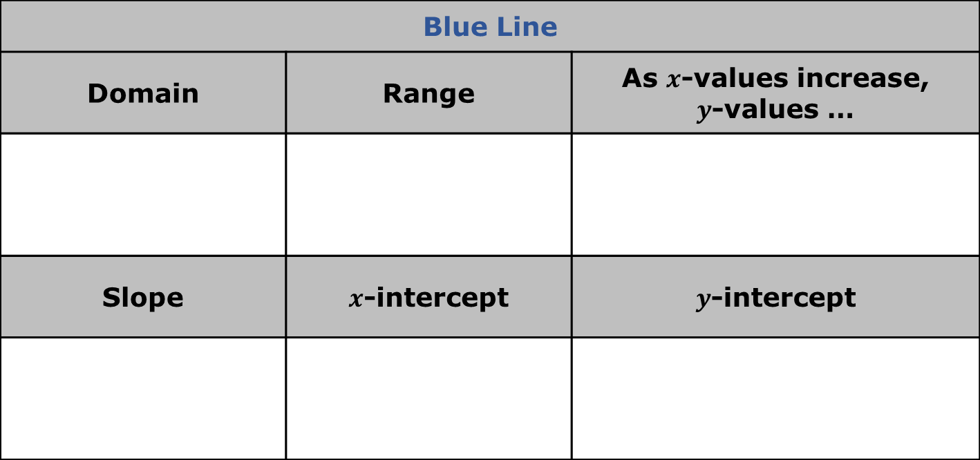
Blue Line
Domain | Range | As $x$-values increase, $y$-values …
Slope | $x$-intercept | $y$-intercept
How does the range of a horizontal line relate to its 𝑦‑intercept?
How does the domain of a vertical line relate to its 𝑥‑intercept?
volume 1, pg. 173

Slide 23

Wrap-Up
volume 1, pg. 174

Slide 24
4.2.4 Wrap-Up: Reflection
Complete each statement as you reflect on today’s learning.
The concept that made the most sense to me today is…
One concept that I still do not understand from today is…
volume 1, pg. 174

